Slide 1
Road Accidents Analysis
Data Science Project
By - Shruti Gupta

Slide 2
Introduction
The Regulatory Affairs of Road Accidents have provided a dataset which contains road accident information for 50 cities of India in the year 2020

Slide 3
Objective
To analyze the dataset for the causes, outcomes of accidents and city.
To visualize the same with graphs

Slide 4
Tools & Frameworks Used
Python for EDA
Matplotlib and Seaborn libraries for visualization

Slide 5
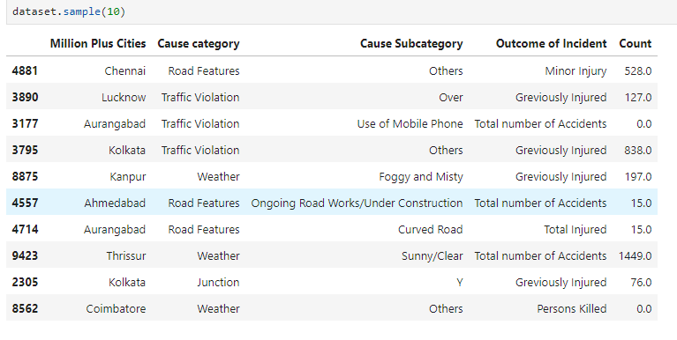
Dataset
Random 10 rows of dataset

Slide 6
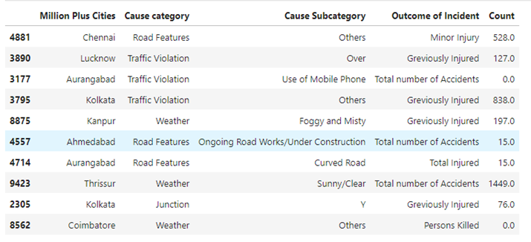
Dataset contains 5 columns
The analysis will be done based on the following features
Million Plus Cities
Cause Category
Cause Subcategory
Outcome of Incident
Output
Count

Slide 7

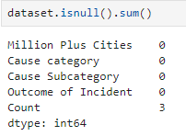
EDA – Data Cleaning
Find the size of the dataset
Check for nulls
Fill the null values with 0

Slide 8
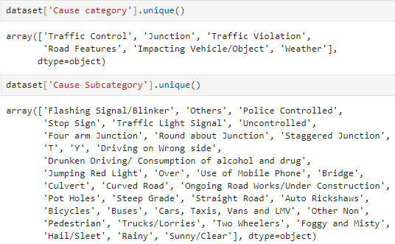
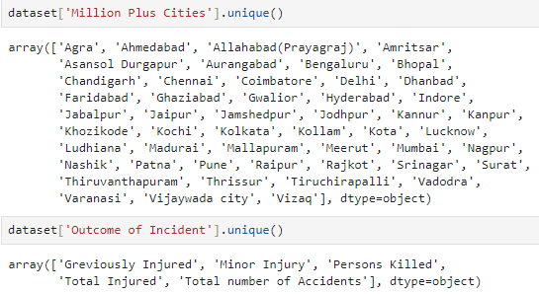
EDA – Data Preprocessing
Find the unique values for features, as they are categorical

Slide 9
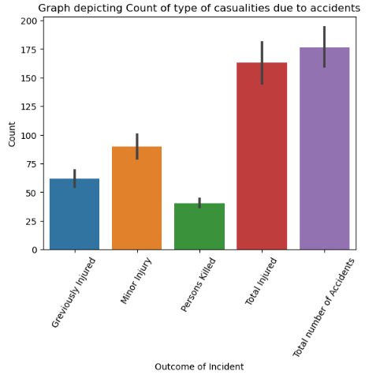
Data Visualization
Outcomes of incidents vs Count
INFERENCE
Maximum road accidents resulted in injuries and minor injuries

Slide 10
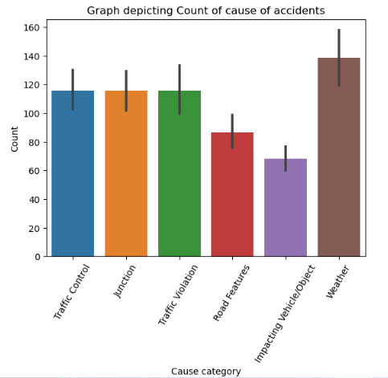
Data Visualization
Cause category vs Count
INFERENCE
Maximum road accidents were caused due to Weather

Slide 11
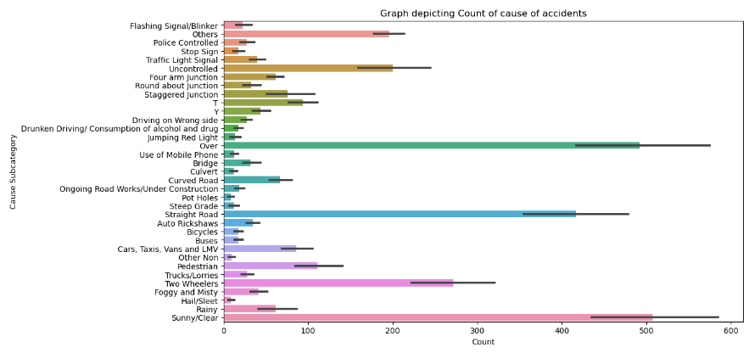
INFERENCE
Maximum road accidents were caused due to Sunny/Clear Weather, Straight Road and Other reasons
Cause Subcategory vs Count

Slide 12
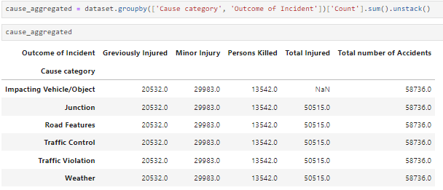
EDA
Table shows the cause category for each outcome

Slide 13
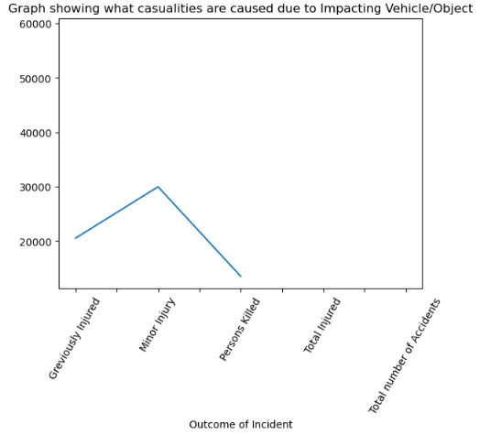
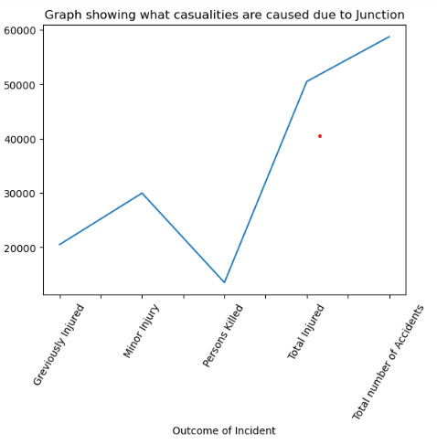
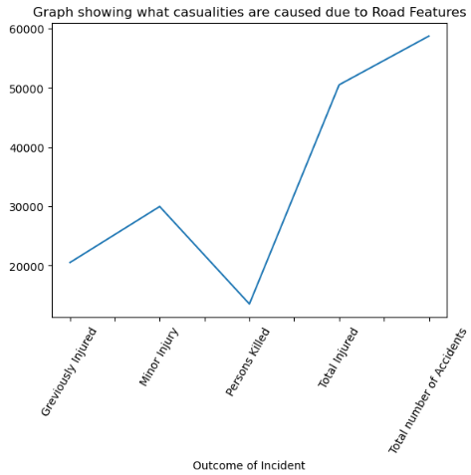


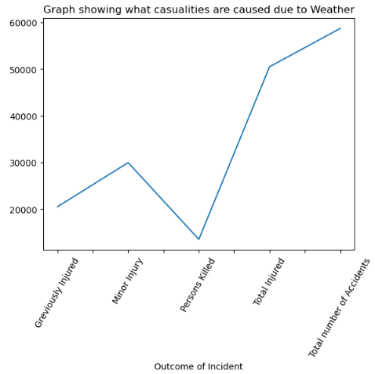
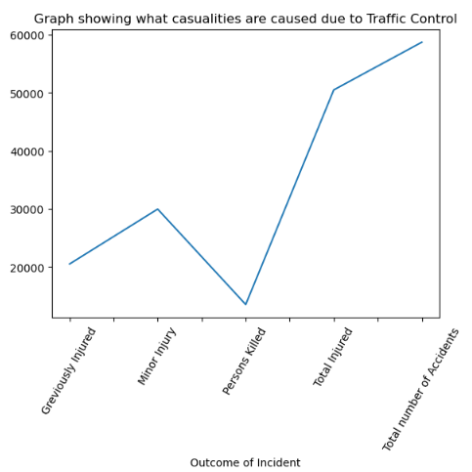
Graphs are plotted for each Category with the counts of ‘Outcomes of Incident’
INFERENCE
Maximum road accidents led to minor injuries for any cause

Slide 14
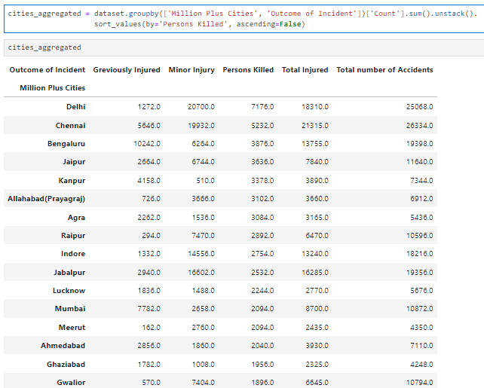
Table shows the no. of injuries caused in each city, sorted by maximum Deaths
INFERENCE
Maximum accidents that
resulted in death occurred in Delhi

Slide 15
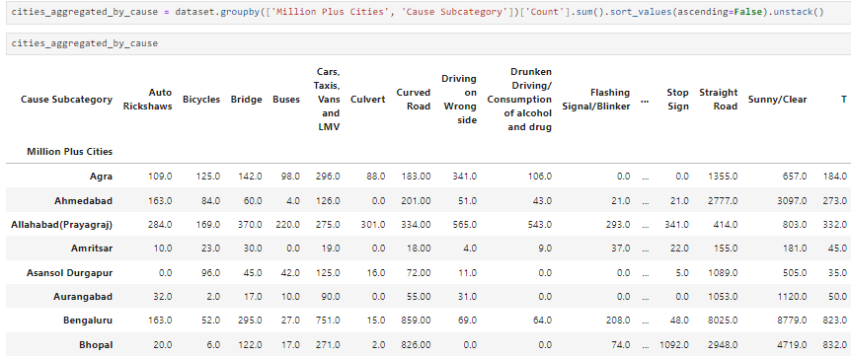
EDA
Table shows the no. of accidents for each city- cause subcategory wise

Slide 16
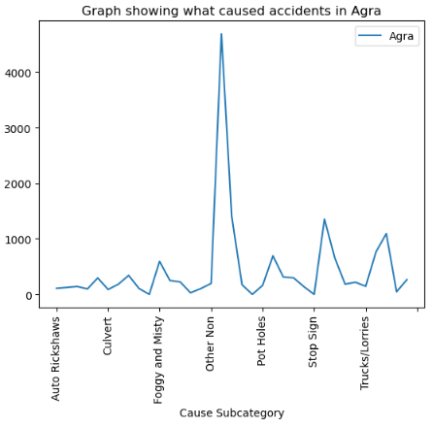
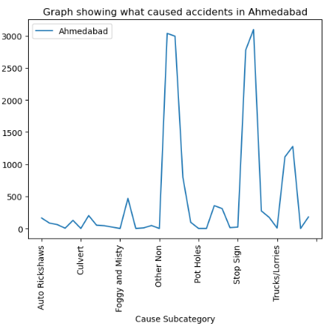
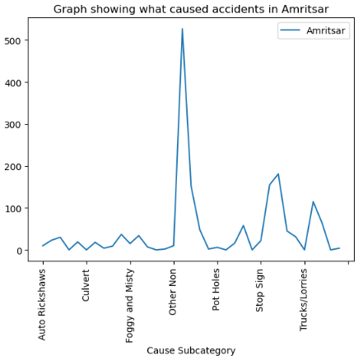
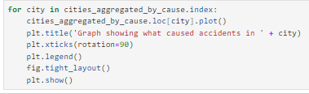
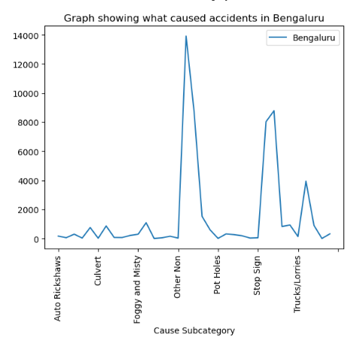
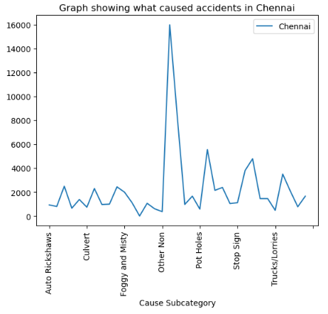
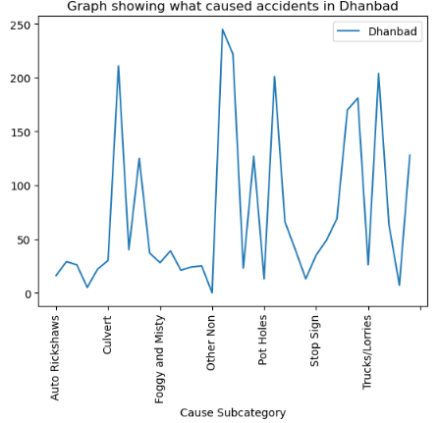
Graphs are plotted for each city with the cause of accidents
INFERENCE
Maximum accidents have been caused due to ‘Stop Sign’
In Dhanbad, accidents have been caused due to many causes

Slide 17
Thank You!
Shruti Gupta

